Slide 1
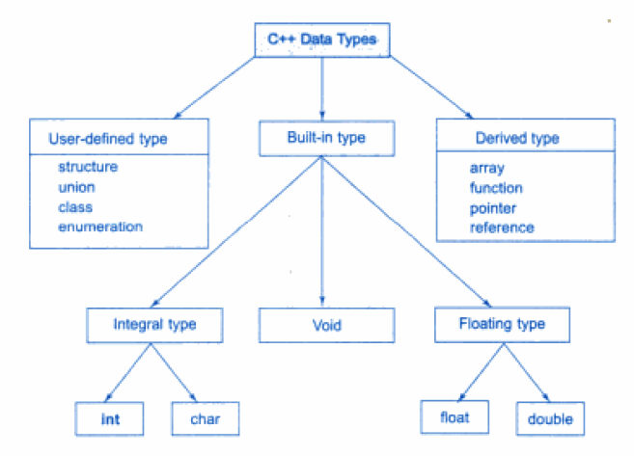
Pointer data type

Slide 2
Topics
Pointers
Memory addresses
Declaration
Dereferencing a pointer
Pointers to pointer
Static vs. dynamic objects
new and delete

Slide 3
Computer Memory
Each variable is assigned a memory slot (the size depends on the data type) and the variable’s data is stored there
Memory address:
1020
1024
1032
…
…
100
…
1024
…
a
Variable a’s value, i.e., 100, is
stored at memory location 1024
int a = 100;

Slide 4
Pointers
A pointer is a variable used to store the address of a memory cell.
We can use the pointer to reference this memory cell
Memory address:
1020
1024
1032
…
…
100
…
1024
…
integer
pointer

Slide 5
Pointer Types
Pointer
C++ has pointer types for each type of object
Pointers to int objects
Pointers to char objects
Pointers to user-defined objects
(e.g., RationalNumber)
Even pointers to pointers
Pointers to pointers to int objects

Slide 6
Pointer Variable
Declaration of Pointer variables
type* pointer_name;
//or
type *pointer_name;
where type is the type of data pointed to (e.g. int, char, double)
Examples:
int *n;
float *r;
int **p; // pointer to pointer

Slide 7
Address Operator &
The "address of " operator (&) gives the memory address of the variable
Usage: &variable_name
Memory address:
1020
1024
…
…
100
…
…
…
a
int a = 100;
//get the value,
cout << a; //prints 100
//get the memory address
cout << &a; //prints 1024

Slide 8
Address Operator &
Memory address:
1020
1024
1032
…
88
100
…
…
…
a
b
#include <iostream>
using namespace std;
void main(){
int a, b;
a = 88;
b = 100;
cout << "The address of a is: " << &a << endl;
cout << "The address of b is: " << &b << endl;
}
Result is:
The address of a is: 1020
The address of b is: 1024

Slide 9
Pointer Variables
The value of pointer p is the address of variable a
A pointer is also a variable, so it has its own memory address
Memory address:
1020
1024
1032
…
88
100
…
1024
…
a
p
int a = 100;
int *p = &a;
cout << a << " " << &a <<endl;
cout << p << " " << &p <<endl;
Result is:
100 1024
1024 1032

Slide 10
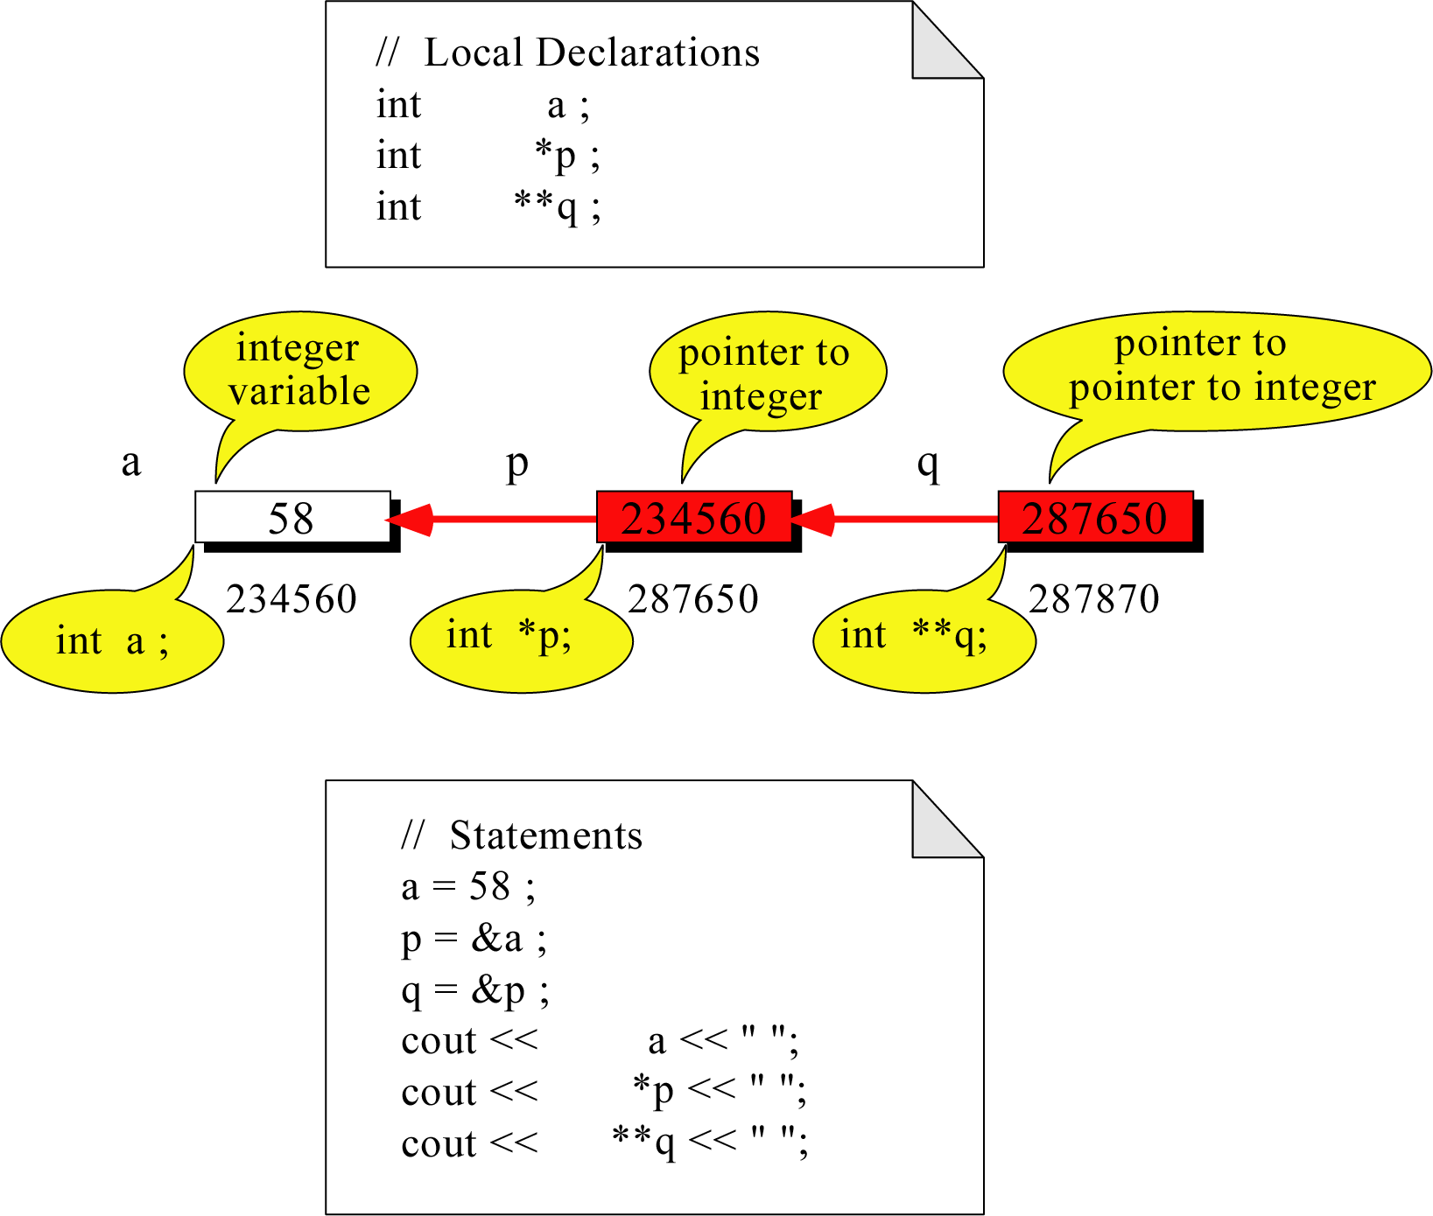
Pointer to Pointer
What is the output?
58 58 58

Slide 11
Dereferencing Operator *
We can access to the value stored in the variable pointed to by using the dereferencing operator (*),
Memory address:
1020
1024
1032
…
88
100
…
1024
…
a
p
int a = 100;
int *p = &a;
cout << a << endl;
cout << &a << endl;
cout << p << " " << *p << endl;
cout << &p << endl;
Result is:
100
1024
1024 100
1032

Slide 12
Don’t get confused
Declaring a pointer means only that it is a pointer: int *p;
Don’t be confused with the dereferencing operator, which is also written with an asterisk (*). They are simply two different tasks represented with the same sign
int a = 100, b = 88, c = 8;
int *p1 = &a, *p2, *p3 = &c;
p2 = &b; // p2 points to b
p2 = p1; // p2 points to a
b = *p3; //assign c to b
*p1 = *p3; //assign c to a
cout << a << b << c;
Result is:
888

Slide 13
Reference Variables
A reference is an additional name to
an existing memory location
Pointer:
Reference:
x
9
x
ref
9
ref
int x = 9;
int &ref = x;
int x=9;
int *ref;
ref = &x;
Notes:
References fix some of those pointer problems.
If we wanted something called “ref” to point to a variable x, we’d declare a pointer variable and assign the address of x into it. With references, we’d attach an additional name – ref – to the same memory location as x.
Note how the pointer necessitates an extra variable, whereas the reference didn’t

Slide 14
Reference Variables
A reference variable serves as an alternative name for an object
int m = 10;
int &j = m; // j is a reference variable
cout << “value of m = “ << m << endl;
//print 10
j = 18;
cout << “value of m = “ << m << endl;
// print 18

Slide 15
Reference Variables
A reference variable always refers to the same object. Assigning a reference variable with a new value actually changes the value of the referred object.
Reference variables are commonly used for parameter passing to a function

Slide 16
Pass by Reference
void IndirectSwap(char& y, char& z) {
char temp = y;
y = z;
z = temp;
}
int main() {
char a = 'y';
char b = 'n';
IndirectSwap(a, b);
cout << a << b << endl;
return 0;
}

Slide 17
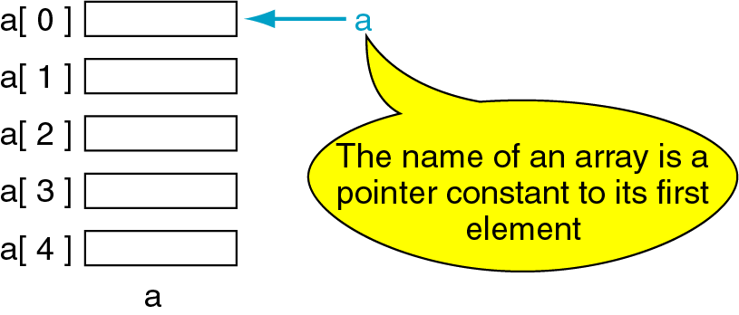
Pointers and Arrays
The name of an array points only to the first element not the whole array.
1000
1004
1008
1012
1016

Slide 18
Array Name is a pointer constant
#include <iostream>
using namespace std;
void main (){
int a[5];
cout << "Address of a[0]: " << &a[0] << endl
<< "Name as pointer: " << a << endl;
}
Result:
Address of a[0]: 0x0065FDE4
Name as pointer: 0x0065FDE4

Slide 19
Dereferencing An Array Name
This element is called a[0] or *a
#include <iostream>
using namespace std;
void main(){
int a[5] = {2,4,6,8,22};
cout << *a << " "
<< a[0];
} //main
a[0]
2
a
a[1]
4
a[2]
6
a[3]
8
a[4]
22
a

Slide 20

Array Names as Pointers
To access an array, any pointer to the first element can be used instead of the name of the array.
We could replace *p by *a
#include <iostream>
using namespace std;
void main(){
int a[5] = {2,4,6,8,22};
int *p = a;
cout << a[0] << " "
<< *p;
}
a
p
a[0]
2
2 2
a[1]
4
a[2]
6
a[3]
8
a[4]
22
a

Slide 21
Multiple Array Pointers
Both a and p are pointers to the same array.
#include <iostream>
using namespace std;
void main(){
int a[5] = {2,4,6,8,22};
int *p = &a[1];
cout << a[0] << " "
<< p[-1];
cout << a[1] << " "
<< p[0];
}
a[0]
a[0]
2 2
4 4
2
p
a[1]
4
a[2]
6
p[0]
a[3]
8
a[4]
22

Slide 22
Pointer Arithmetic
Given a pointer p, p+n refers to the element that is offset from p by n positions.
a
2
p - 1
4
p
a + 1
a + 2
6
p + 1
a + 3
8
p + 2
a + 4
22
p + 3

Slide 23
Dereferencing Array Pointers
a[0] or *(a + 0)
2
a
a[1] or *(a + 1)
4
a + 1
a[2] or *(a + 2)
6
a + 2
a[3] or *(a + 3)
8
a + 3
a[4] or *(a + 4)
22
a + 4
*(a+n) is identical to a[n]
Note: flexible pointer syntax

Slide 24
Array of Pointers & Pointers to Array
a
p
b
c
An array of Pointers
A pointer to an array
int a = 1, b = 2, c = 3;
int *p[5];
p[0] = &a;
p[1] = &b;
p[2] = &c;
int list[5] = {9, 8, 7, 6, 5};
int *p;
P = list;//points to 1st entry
P = &list[0];//points to 1st entry
P = &list[1];//points to 2nd entry
P = list + 1; //points to 2nd entry

